Slide 1
Autonomous Cars
Daria Zahaleanu

Slide 2
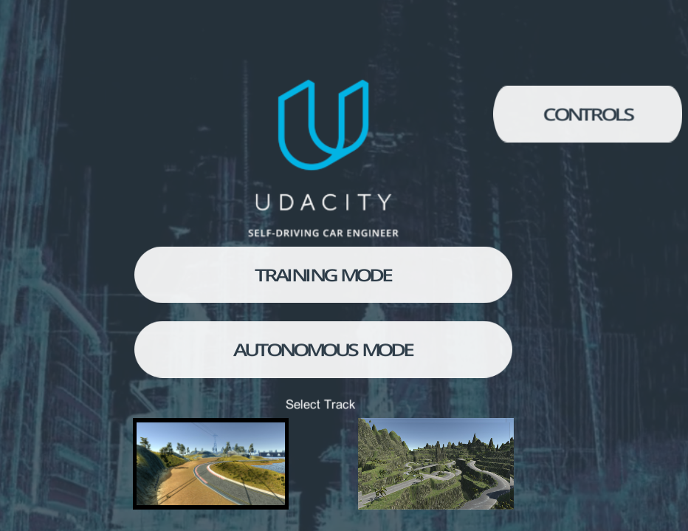

Slide 3
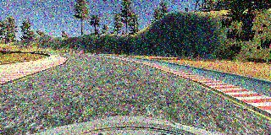
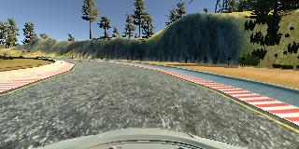
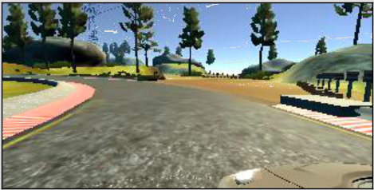
Pixel Attack

Slide 4
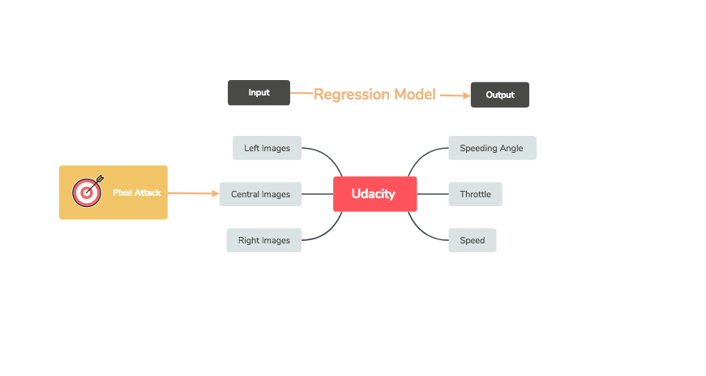

Slide 5
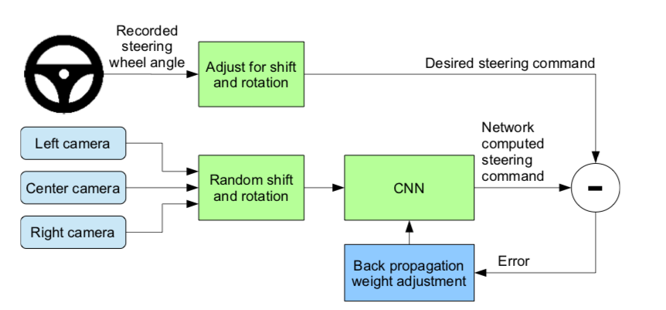
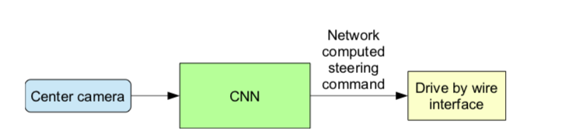
Training Mode
Autonomous Mode

Slide 6
Results
Pixelated images get trained
Autonomous mode doesn’t work

Slide 7
Black-Box Attacks
in black-box attacks, the adversary doesn’t have any knowledge about the model, except for the the labels
the goal is to produce a minimal perturbation to input X, sufficient to determine the DNN to misclassify it, but imperceptible enough for the human eye
Notes:
Unlike the other two type of attacks, classified as white-box attacks, as the adversary has full access to the internal structure of the classifier, in black-box attacks, the adversary doesnâ€™t have any knowledge about the model, except for the the labels, the allow him/her access to the output only. The goal is as we previously saw, to produce a minimal perturbation to input X, sufficient to determine the DNN to misclassify it, but imperceptible enough for the human eye. The approach to this type of attack is as following: use DNN as an orale to synthesized data and generate a synthetic data set S0 to build a model F that approximates the oracleâ€™s decision. Then using the new architecture F to craft adversarial samples, the oracle outputs a misclassified probability vector, corresponding to input X*. This step, called substitute DNN training algorithm, ends with the Jacobian-based dataset augmentation, which generates a new set of data S (Figure 7). Once the adversary training a substitute DNN, it uses it to craft adversarial samples, by using two types of algorithms: Goodfellow, or the fast gradient sign method and Papernot. Therefore, the black-box attack generalizes to machine learning models that are not necessarily DNNs, regardless of the differentiability of the functions.

Slide 8
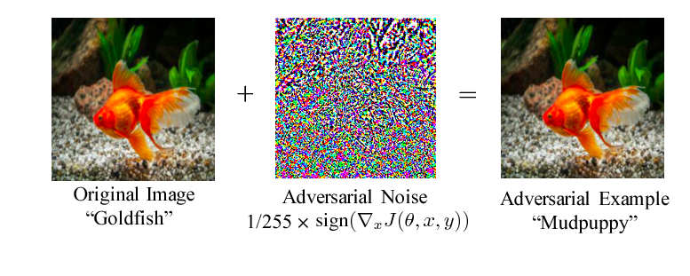
One Pixel Attack
Notes:
The black-box attack requires only the probability labels (the probability value for each category) that get outputted by the neural network.

Slide 9
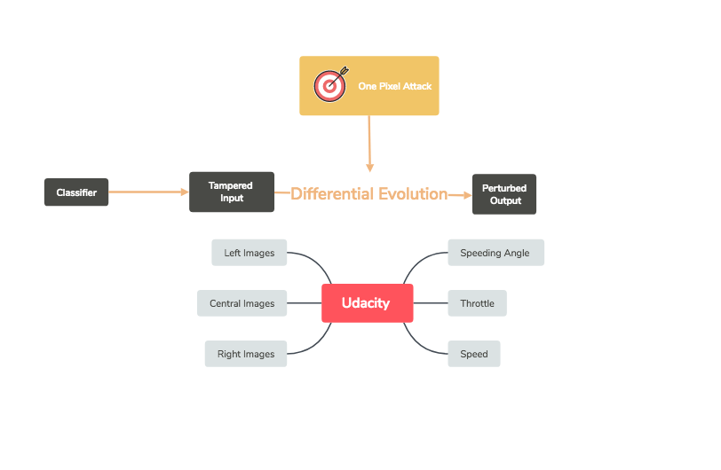

Slide 10
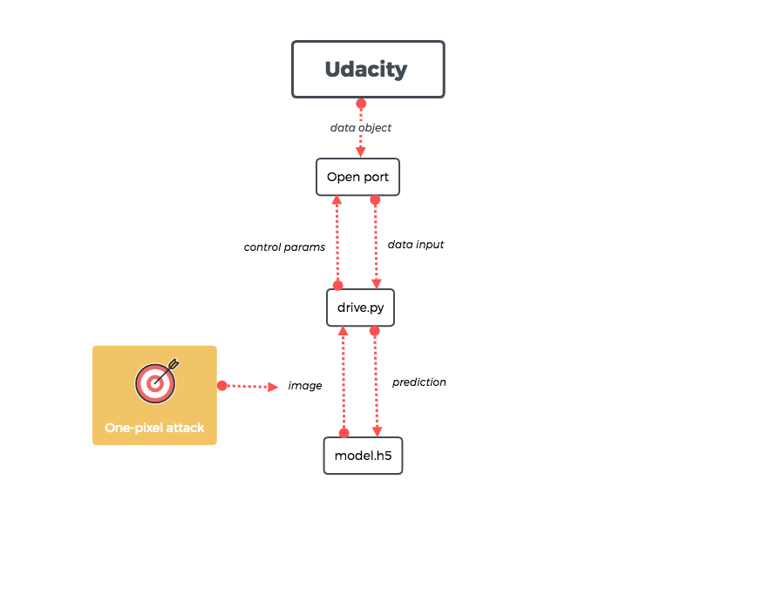

Slide 11
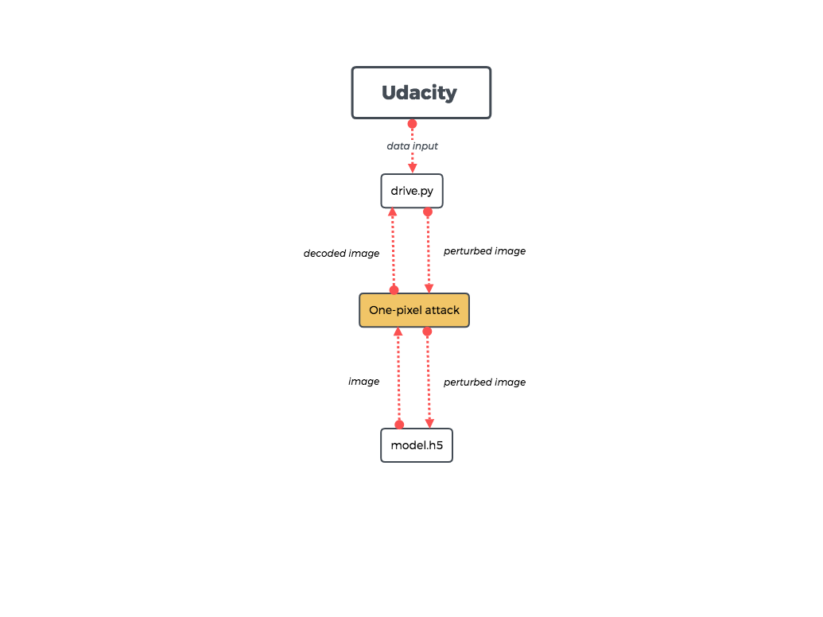

Slide 12
Future Work
Quantify the how the perturbations affect the autonomous mode
Fully implement the one-pixel attack
Try to implement a genetic algorithm

